Slide 1

Democracy as a scaled collective intelligence process: points of vulnerability and augmentation
Marc-Antoine Parent
Conversence
orcid: 0000-0003-4159-7678
Notes:
Parler de moi: Dev, fana d’IA depuis les années 80, travail sur outils basés sur l’IA dans les années 90, puis sur le Web sémantique, puis…
Évolution de l’idée d’intelligence

Slide 2
Agenda
01 | Democracy as a rational decision mechanism
02 | Democracy as social negotiation
03 | AI as a coordination mechanism
04 | Structured conversations
Notes:
Analysis, Critique, Agenda

Slide 3
Democracy as a rational decision mechanism

Slide 4
Optimize decisions
Based on an idealized decision model
Criterion
Criterion
Consequence
Action
Consequence
Situation
Action
Consequence
Consequence
Decision
Objective
Action

Slide 5
From the outside
Situation
Action
Consequence
Objectives
Notes:
Some layers are just aggregated, others negotiated. Mark that?

Slide 6

Private theory
Raw Situation
Perceived Situation
Action
Consequence
Objectives
Interpretation
Follow-up and track deviations
Classification
Implementation
Private
theory
Situation Schema
Action Plan
Expected Consequence
Criteria
Selection
Evaluation
Notes:
Some layers are just aggregated, others negotiated. Mark that?

Slide 7
Corrections
Raw Situation
Perceived Situation
Action
Consequence
Objectives
Interpretation
Follow-up and track deviations
Classification
Implementation
Corrections
Private
theory
Situation Schema
Action Plan
Expected Consequence
Criteria
Selection
Evaluation
Notes:
Some layers are just aggregated, others negotiated. Mark that?

Slide 8
Theory from experience
Raw Situation
Perceived Situation
Action
Consequence
Interpretation
Follow-up and track deviations
Memorisation
Classification
Implementation
Corrections
Theory
Situation Schema
Action Plan
Expected Consequence
Criteria
Selection
Evaluation
Abstraction / Clustering
Causal theory
Past memory
Objectives
Situation
Action
Objectif
Situation
Action
Objectif
Situation
Action
Consequence
Notes:
Some layers are just aggregated, others negotiated. Mark that?

Slide 9
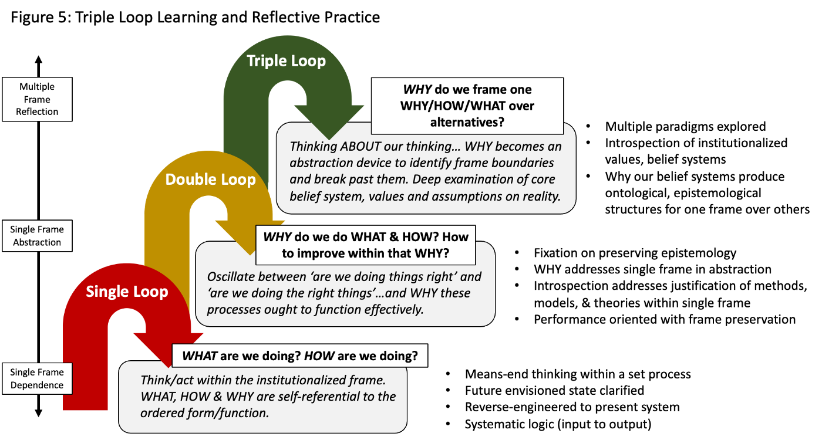
Learning as layered feedback loops
https://aodnetwork.ca/triple-loop-learning-moving-beyond-the-pale-of-the-institutional-limits, according to Flood & Romm, according to Bateson

Slide 10
Collective Decision
Raw Situation
Perceived Situation
Action
Consequence
Interpretation
Follow-up and track deviations
Memorisation
Classification
Implementation
Corrections
Culture
& Rules
Situation Schema
Action Plan
Expected Consequence
Criteria
Selection
Evaluation
Abstraction / Clustering
Causal theory
Negotiation
Action
Collective memory
Action
Objectives
Situation
Action
Objectif
Situation
Action
Objectif
Situation
Action
Consequence
Notes:
Some layers are just aggregated, others negotiated. Mark that?

Slide 11
Assumptions of the rational decision model
Accurate Knowledge
How much do we actually know about the possible options and probabilities? Do we know all side effects and feedback loops?
Cognitive Capacity
Even if the knowledge exists, how many different options can we think about?
Requisite Variety
Is the system’s representational capacity adequate to its environment’s complexity?
Objective alignment
Is the decision process actually aligned with the stated objective criteria?
Stable causality regime
Are consequences mostly knowable from the actions?
Are we in a complex or chaotic causality regime? (cf. Cynefin)
Are we in an unprecedented situation? (Learning)

Slide 12
DEMOCRACY AS SOCIAL NEGOTIATION

Slide 13
Cognition as a social process
Under certain conditions, collective cognition is more accurate
  Requisite variety vs group-think
  Compatible goals vs polarization
  Cognitive biases such as confirmation biases are valuable labour-sharing heuristics in collective cognition.
  Did evolution primarily optimize the latter?
Enactive cognition: society as part of the thinking environment
Verified in deliberative polling and citizen assemblies

Slide 14
Institutions as stewards of feedback loops
First loop: What are we doing
  Bureaucracy for measurement
  Police / judicial / auditors identify deviations
  Journalists direct collective attention to deviations
Second loop: Theory building
  Scholarship / Science
  Culture
Third loop: Why are we doing this?
  Public agora
  (Counter-)Culture
  Elections
Fourth loop: Improving on the process
  Political philosophy
  Epistemology

Slide 15
Criteria: Why the institutions
Verification
Deliberation
Accountability
Trust
Accuracy
Alignment
Cognitive Capacity
Learning
Learning Capacity
Goal Coherence
Representativity
Action Coherence
Expertise
Scalability
Diversity
Equality
Freedom
Upwards Control
Clarity
Abstraction
Approachability
Connectedness

Slide 16
Scaling the learning process
Learning loops have an overhead ∝ accumulated knowledge
Trade-off between accuracy and cost of research (+ cognitive overhead)
Trade-off between coherent policies and adapting to diverse concerns
 | Adaptable | Coherent | Accurate | Scalable
Atomized | ++ | -- | - | ++
Centralized | -- | ++ | -- | ++
Technocratic | ˜ | + | + | ˜
Dialogic | + | + | + | --

Slide 17
Where / WHEN to invest in dialogue
Raw Situation
Perceived Situation
Action
Consequence
Interpretation
Follow-up and track deviations
Memorisation
Classification
Implementation
Corrections
Culture
& Rules
Situation Schema
Action Plan
Expected Consequence
Criteria
Selection
Evaluation
Abstraction / Clustering
Causal theory
Negotiation
Action
Collective memory
Action
Objectives
Situation
Action
Objectif
Situation
Action
Objectif
Situation
Action
Consequence
Notes:
Some layers are just aggregated, others negotiated. Mark that?

Slide 18
Learning in the lifeworld
Habermas: The System(atized) vs the LifeWorld
  Socialization, Social Integration, Cultural Reproduction
  Lines of lived transmission: Mentorship, Families, Culture…
  Colonization of the LifeWorld by the system
Political agonism: Communities in interaction
  Identifying shared goals for conflict resolution
  Rawls: The evolution of overlapping consensus
Notes:
Habermas following Schutz and Parsons, following Weber and Husserl…

Slide 19
AI as a coordination mechanism

Slide 20
Generative AI as compressed history
Access to a gigantic corpus (through lossy compression)
Automated abstraction through statistics
Mostly works at level of linguistic concepts
Gives access to a considerable shared memory
Notes:
(WEIRD memory: Western, educated, industrialized, rich and democratic)
Hallucinations as a compression artefact

Slide 21
The black box problem
Unreliable introspection
  Comparable to human introspection?
Explainable AI in terms of proximate causes
Hidden biases
  In the original corpus
  In the training process
  In the post-training instructions
Biases are already being weaponized
Notes:
Russian pollution of sources, mechahitler…

Slide 22
Human reactions to AI
Attribution of intentionality
  From Thunder gods to Eliza to ChatGPT
Illusion of Authoritativeness through fluency
Sycophancy as a Service
  Psychological dependency
  Amplifies confirmation bias
Human-in-the-loop
  Checking is not less difficult than thinking
  Reverse centaurs as moral crumple zone
  Cognitive degradation
Notes:
Eg of oncologists, Cognitive degradation

Slide 23
Hijacking the learning loops
The basis of the conversation:
  Verification: We cannot verify a black box
  Deliberation: Artificial man in the middle
  Accountability: Accountability sink
Impact on social learning
  Generative AI’s learning stops after training, preventing cultural iteration
Impact on trust
  Are the ideas coming from you? If not, whose interest are they serving?
  AI-powered bubbles
Notes:
Accountability sink: cf consultants

Slide 24
Whose conversation?
Generative AI and labour power dynamics
Enclosure of the knowledge commons
Explicit links to TESCREAL and autocratic projects
Bare minimum of representative democracy:
When can we vote out an AI?
Or deliberate on its role in the process?
Notes:
Transhumanism, Extropianism, Singularitarianism, (modern) Cosmism, Rationalist ideology, Effective Altruism, and Longtermism.

Slide 25
Structured conversations:
A step to an Augmented Collective Intelligence
Notes:
Structured conversations: Rethinking the feedback loop
On the 4th loop

Slide 26
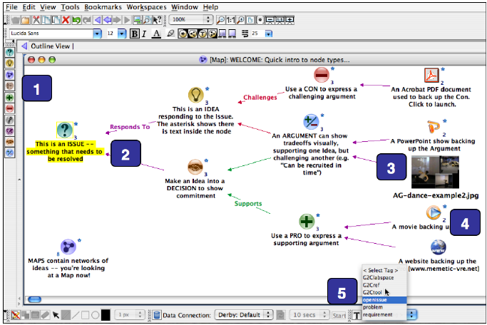
History of structured conversations
Technical languages
Formal logics
Dialogue mapping
  Works well with a live cartographer
  Helps defuse personal hostility
  Overwhelmed without curation, offline

Slide 27
Why structured?
Deduplication
  Reduces cognitive footprint
  Avoids vote splitting
Ideas can be compared
  Lattice (Formal Concept Analysis)
Ideas can be composed
Fractal views
  Allows to focus attention

Slide 28
Structured AND PERSONAL AND Social
Progressive formalization
  Keep link between abstraction and concrete experiences
  Choral explanations
Negotiated sense-making
  Disputed interpretations
Continuously throughout the social learning loop!

Slide 29
roles for open Hybrid AI
Hybrid: The knowledge base can be a subject of deliberation
Open: allowing for public scrutiny of the whole process
Translation : Across specialized vocabularies
Approachability : Help people approach formalized knowledge
Mentoring : help people make their thought more precise
With heavy supervision:
Surface inconsistencies
Synthesis across many contributions

Slide 30
Requirements for transparency
Curated maps for intelligibility
  With alternatives and computed neighbourhoods
Transparent algorithms
  Ordering
  Moderation
Coherence markers
Provenance
  Mark black-box input

Slide 31
Requirements for adoption
ANTI-GOAL: One schema to rule them all!
Evolutive negotiated vocabularies
Federated architecture
Emphasis on pedagogy

Slide 32
Past and Current projects
IdeaLoom.org : Earlier work on an idea sharing and clustering workbench
  First attempt at an exchange format for collective intelligence
  From flow to stocks, progressive formalization
HyperKnowledge.org : Federated knowledge negotiation architecture
  For evolving ideas
SenseCraft.garden: coopetitive game to build a structured conversation
ClaimMiner.info : identification of discourse patterns in text
DiscourseGraphs.com : Structured conversations for research teams

Slide 33
An augmented social learning loop
Instead of AI improving AI…
Social cognition improving social cognition processes (4th loop)
In full transparency
With black boxes only helping at the process margins
This may require rethinking our language of collaboration
Co-building an ecosystem of tools to augment collective intelligence
Join us!

